Slide 1
Outline of Business Idea and Implementation Steps
Comprehensive plan from concept to operational strategy
Notes:
AI-generated content may be incorrect. --- This presentation outlines a comprehensive business idea and the step-by-step process to implement it effectively. We will cover everything from the business concept to market analysis, setup procedures, and operational strategies.

Slide 2
Business Idea and Implementation Agenda
Business Concept Overview
Overview of Thailand's Local Cleaning Industry
Market Analysis and Competitive Advantages
Step-by-Step Business Setup Process
Operations, Marketing, and Compliance
Business Setup Summary Table (English)
Business Setup Summary Table (Thai)
Additional Resources
Notes:
We will begin by discussing the business concept and its unique value. Then, explore Thailand's local cleaning industry, analyze the market and competitive advantages, review the business setup process, operations, marketing, compliance, and conclude with summary tables and additional resources.

Slide 3
Business Concept Overview
Notes:
--- This slide references information from the following file: https://nextflowth-my.sharepoint.com/personal/teerasej_nextflowth_onmicrosoft_com/_layouts/15/Doc.aspx?sourcedoc=%7BFB659DDD-7793-449A-868A-0B52F230D32C%7D&file=Business%20Idea.docx&action=default&mobileredirect=true&DefaultItemOpen=1 Company focus and unique selling points

Slide 4

Company focus and unique selling points
Specialized Cleaning Services
The company specializes in cleaning offices and commercial spaces in New York City, ensuring professional service.
Eco-Friendly Materials
Using eco-friendly cleaning materials promotes sustainability and reduces environmental impact.
Local Contractors and Equipment
Employing local contractors and providing them with equipment supports the community and ensures quality.
Startup Budget Planning
Initial startup costs cover equipment, materials, and marketing with a total budget of $10,000.
Notes:
--- This slide references information from the following file: https://nextflowth-my.sharepoint.com/personal/teerasej_nextflowth_onmicrosoft_com/_layouts/15/Doc.aspx?sourcedoc=%7BFB659DDD-7793-449A-868A-0B52F230D32C%7D&file=Business%20Idea.docx&action=default&mobileredirect=true&DefaultItemOpen=1 A cleaning company based in New York City that specializes in cleaning offices and commercial premises. · Use eco-friendly cleaning materials · Employ local contractors and provide them with cleaning equipment. · Initial startup costs will include equipment and materials, and marketing, with a budget of $10,000. Image source: Microsoft 365 content library

Slide 5
Overview of Thailand's Local Cleaning Industry
Notes:
This section provides an overview of the cleaning market in Thailand, including its size, main players, and current trends shaping the industry.

Slide 6
Market Size and Key Players in Thailand
Growing Cleaning Industry
Thailand's cleaning industry is experiencing growth driven by increasing demand and competition among companies.
Local and Regional Competitors
Numerous local and regional companies compete in Thailand's cleaning market, creating a dynamic business environment.
Market Opportunities and Challenges
Understanding key players and market volume helps identify opportunities and challenges in the cleaning industry.
Notes:
--- Thailand's cleaning industry is growing, with numerous local and regional companies competing. Understanding key players and market volume helps identify opportunities and challenges. Image source: Microsoft 365 content library

Slide 7
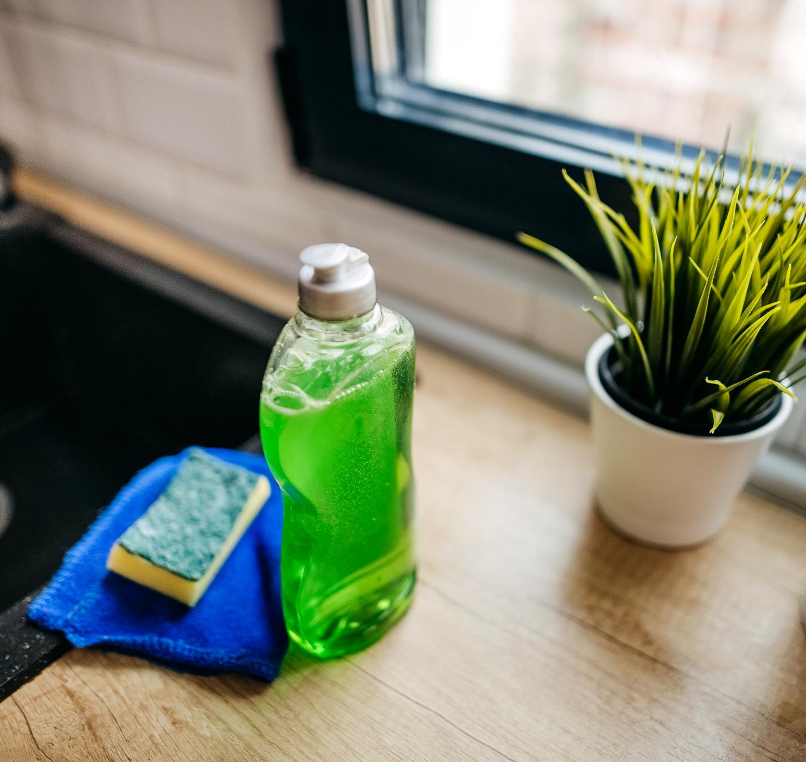
Trends and Opportunities in Local Cleaning Services
Eco-friendly Products
Growing use of environmentally safe and sustainable cleaning products is shaping local cleaning service trends.
Technological Integration
Technology like smart devices and automated tools enhances efficiency and service quality in cleaning businesses.
Specialized Cleaning Services
Increasing demand for niche services such as deep cleaning and sanitation opens new market opportunities.
Notes:
--- Emerging trends such as eco-friendly products, technological integration, and increased demand for specialized cleaning services present significant growth opportunities. Image source: Microsoft 365 content library

Slide 8
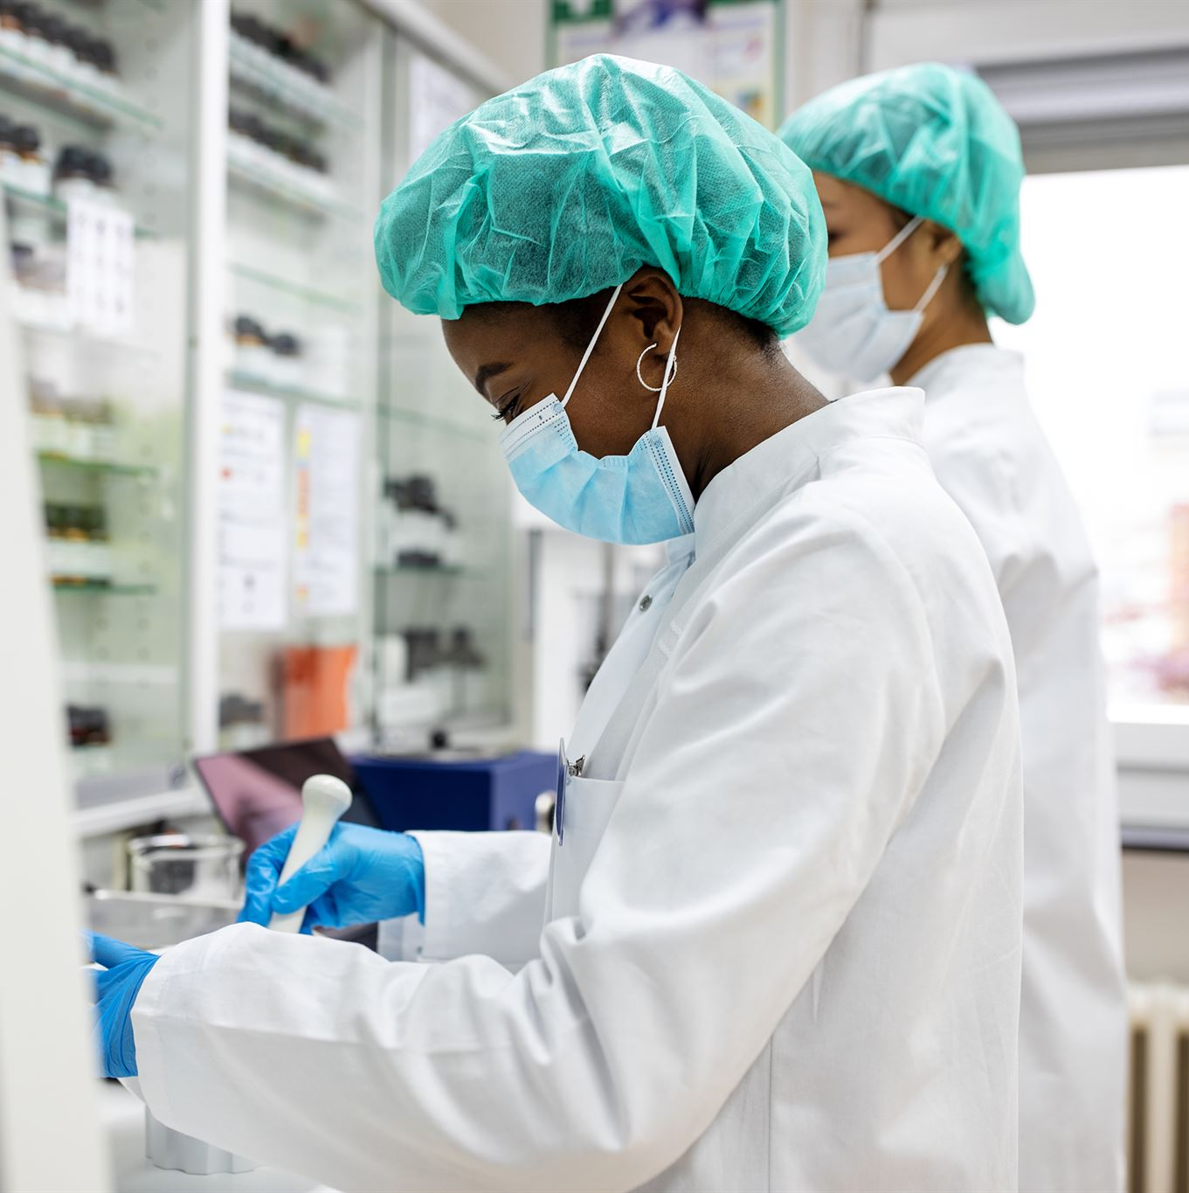
Regulations and Standards for Cleaning Businesses
Legal Compliance Importance
Adhering to local laws ensures legal operation and helps avoid fines or business closure.
Industry Safety Standards
Implementing safety standards protects workers and clients, promoting a safe working environment.
Sustainable Business Practices
Following regulations supports sustainable practices and builds business reputation and trust.
Notes:
--- Compliance with local regulations and industry standards is crucial for sustainable operations. This slide highlights relevant legal and safety requirements. Image source: Microsoft 365 content library

Slide 9
Market Analysis and Competitive Advantages
Notes:
--- This slide references information from the following file: https://nextflowth-my.sharepoint.com/personal/teerasej_nextflowth_onmicrosoft_com/_layouts/15/Doc.aspx?sourcedoc=%7BFB659DDD-7793-449A-868A-0B52F230D32C%7D&file=Business%20Idea.docx&action=default&mobileredirect=true&DefaultItemOpen=1 Market opportunity and trends, Community benefits and differentiation

Slide 10
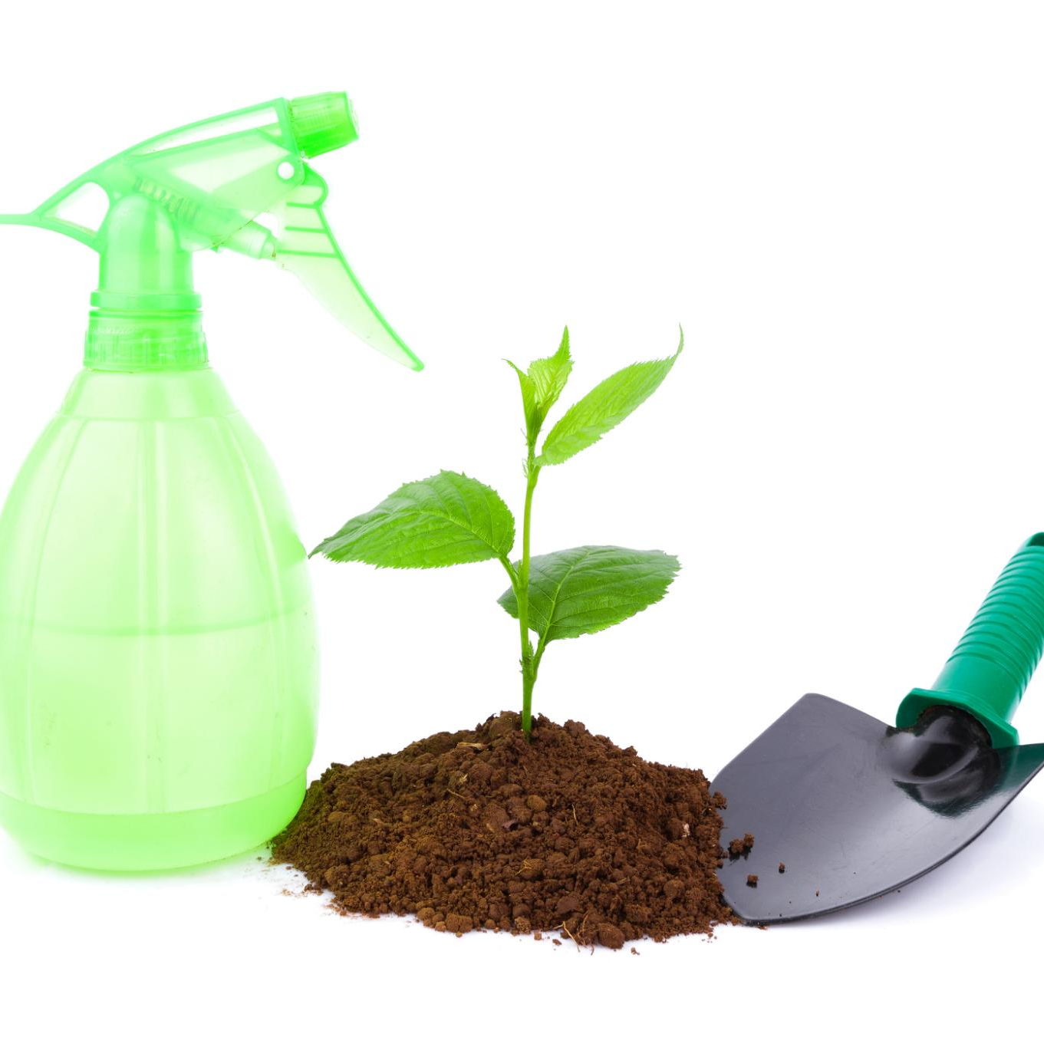
Market opportunity and trends
Growing Demand for Green Products
Consumers increasingly prefer green cleaning products that are safe for the environment and health.
Market Size and Growth
The global green cleaning market was valued at $3.9 billion in 2019, growing annually by 8.4%.
Social and Economic Value
This business supports local communities by creating social and economic benefits alongside environmental impact.
Notes:
--- This slide references information from the following file: https://nextflowth-my.sharepoint.com/personal/teerasej_nextflowth_onmicrosoft_com/_layouts/15/Doc.aspx?sourcedoc=%7BFB659DDD-7793-449A-868A-0B52F230D32C%7D&file=Business%20Idea.docx&action=default&mobileredirect=true&DefaultItemOpen=1 This business idea has a promising market opportunity, as it can meet the needs of both environmentally conscious and quality-seeking customers, while also creating social and economic value in the local area. · The business idea has a growing market because: o More people want to use green cleaning products that are good for the environment and health. o The global green cleaning products market was worth USD 3.9 billion in 2019 and is expected to grow by 8.4% every year until 2027. Image source: Microsoft 365 content library

Slide 11
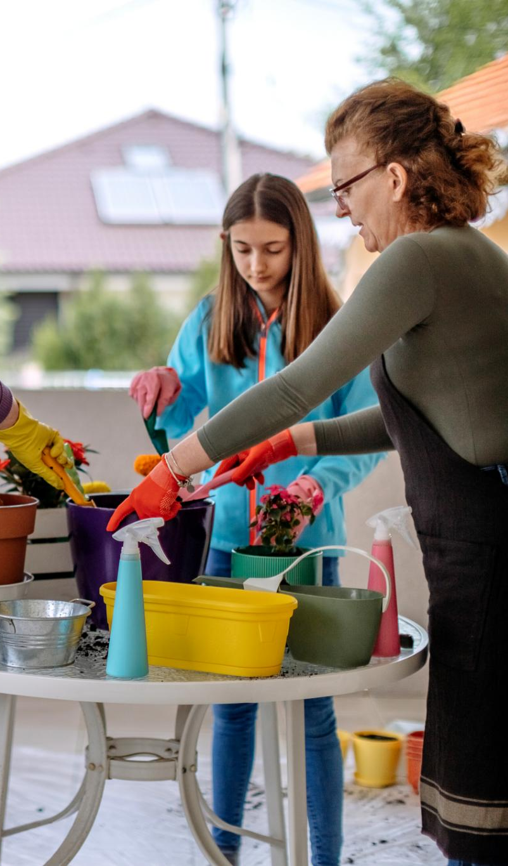
Community benefits and differentiation
Community Economic Benefits
Hiring local contractors and providing equipment creates jobs and income, supporting the community's economy.
Cost Savings and Loyalty
Saving on transportation costs helps build customer loyalty through affordable and reliable services.
Customized Eco-Friendly Solutions
Offering flexible cleaning solutions tailored to eco-conscious and quality-focused clients differentiates the business.
Social and Economic Value
Creating social and economic value in the local area strengthens community ties and business reputation.
Notes:
--- This slide references information from the following file: https://nextflowth-my.sharepoint.com/personal/teerasej_nextflowth_onmicrosoft_com/_layouts/15/Doc.aspx?sourcedoc=%7BFB659DDD-7793-449A-868A-0B52F230D32C%7D&file=Business%20Idea.docx&action=default&mobileredirect=true&DefaultItemOpen=1 · The business idea can also benefit the local community by: o Hiring local contractors and giving them cleaning equipment. o Saving money on transportation and building customer loyalty o Creating jobs and income for the locals. · The business idea can stand out from the competitors by: o Offering cleaning solutions that are customized and flexible for each client. o Meeting the needs and preferences of both eco-friendly and quality-seeking customers. o Creating social and economic value in the local area. Image source: Microsoft 365 content library

Slide 12
Operations, Marketing, and Compliance
Notes:
--- This slide references information from the following file: https://nextflowth-my.sharepoint.com/personal/teerasej_nextflowth_onmicrosoft_com/_layouts/15/Doc.aspx?sourcedoc=%7BFB659DDD-7793-449A-868A-0B52F230D32C%7D&file=Business%20Idea.docx&action=default&mobileredirect=true&DefaultItemOpen=1 Equipment, marketing, and ongoing requirements

Slide 13
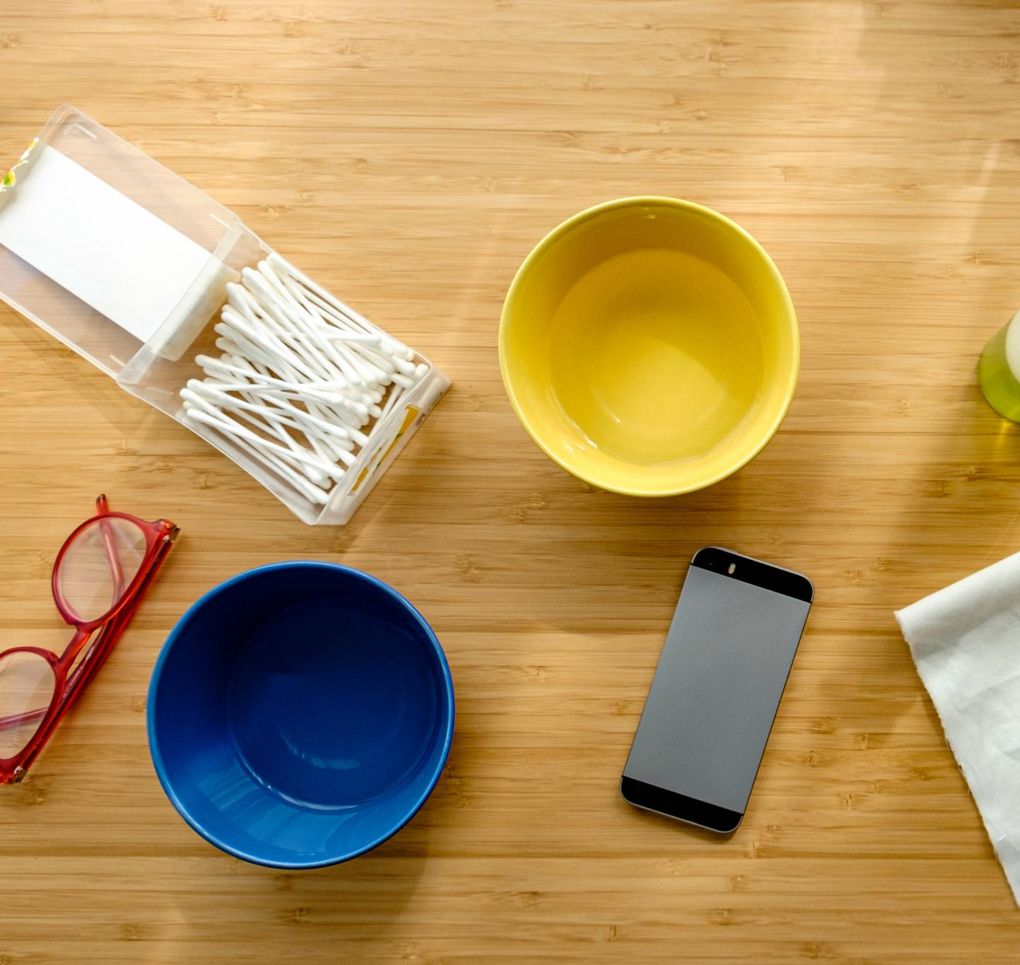
Equipment, marketing, and ongoing requirements
Purchase Eco-Friendly Equipment
Source environmentally friendly cleaning products and equipment as detailed in your business plan.
Marketing Setup and Networking
Create a website, design business cards, launch local marketing, and network with businesses and property managers.
Ongoing Compliance Requirements
File annual financial statements, pay taxes, and renew necessary licenses and permits regularly.
Notes:
--- This slide references information from the following file: https://nextflowth-my.sharepoint.com/personal/teerasej_nextflowth_onmicrosoft_com/_layouts/15/Doc.aspx?sourcedoc=%7BFB659DDD-7793-449A-868A-0B52F230D32C%7D&file=Business%20Idea.docx&action=default&mobileredirect=true&DefaultItemOpen=1 11. Purchase Equipment and Supplies a. Source eco-friendly cleaning products and equipment as outlined in your business plan. 12. Set Up Marketing and Operations a. Build your website, create business cards, and start local marketing. b. Network with local businesses and property managers. 13. Comply with Ongoing Requirements a. File annual financial statements and pay taxes. b. Renew any necessary licenses and permits. Image source: Microsoft 365 content library

Slide 14
Business Setup Summary Table (English)
Notes:
--- This slide references information from the following file: https://nextflowth-my.sharepoint.com/personal/teerasej_nextflowth_onmicrosoft_com/_layouts/15/Doc.aspx?sourcedoc=%7BFB659DDD-7793-449A-868A-0B52F230D32C%7D&file=Business%20Idea.docx&action=default&mobileredirect=true&DefaultItemOpen=1 Summary of business setup steps and details

Slide 15

Summary of business setup steps and details
Structured Business Process
Starting a cleaning business in Thailand involves clear legal and administrative steps for compliance and registration.
Eco-friendly and Licensing Focus
The process highlights eco-friendly service requirements and acquiring necessary local permits and licenses.
Ongoing Compliance and Operations
Annual filings, license renewals, and social security registrations ensure continuous legal operation and compliance.
Comprehensive Setup Workflow
The full workflow covers planning, legal registration, financial setup, hiring, marketing, and operational readiness.
Notes:
--- This slide references information from the following file: https://nextflowth-my.sharepoint.com/personal/teerasej_nextflowth_onmicrosoft_com/_layouts/15/Doc.aspx?sourcedoc=%7BFB659DDD-7793-449A-868A-0B52F230D32C%7D&file=Business%20Idea.docx&action=default&mobileredirect=true&DefaultItemOpen=1 Key Observations - The process for starting a cleaning business in Thailand is highly structured, with clear administrative and legal steps. - Registration and compliance with local authorities (DBD, Revenue Department, Social Security) are emphasized throughout. - Special attention is given to eco-friendly services and local permits, reflecting market and regulatory trends. - Ongoing requirements such as annual filings and license renewals are necessary for continued operation. Detailed Analysis The table outlines a comprehensive step-by-step workflow for establishing a cleaning business in Thailand, beginning with the development of a business plan that includes service definition and budgeting. The process then moves through legal and administrative stages: choosing a business structure (typically a Limited Company for foreign owners), reserving a company name, and preparing required documents for registration. After filing with the Department of Business Development and paying fees, the business must obtain a company seal and tax ID, open a bank account, and register for VAT if revenue thresholds are met. Additional steps include securing any necessary business licenses, hiring employees and registering them for social security, and purchasing equipment—particularly eco-friendly supplies. Marketing and operational setup are also highlighted, with recommendations to build a website and network locally. Finally, the workflow stresses the importance of ongoing compliance, such as filing annual financial statements and renewing licenses, ensuring the business remains in good standing with Thai authorities. Image source: Microsoft 365 content library

Slide 16
Business Setup Summary Table (Thai)
Notes:
--- This slide references information from the following file: https://nextflowth-my.sharepoint.com/personal/teerasej_nextflowth_onmicrosoft_com/_layouts/15/Doc.aspx?sourcedoc=%7BFB659DDD-7793-449A-868A-0B52F230D32C%7D&file=Business%20Idea.docx&action=default&mobileredirect=true&DefaultItemOpen=1 Summary of business setup steps and details (Thai language)

Slide 17
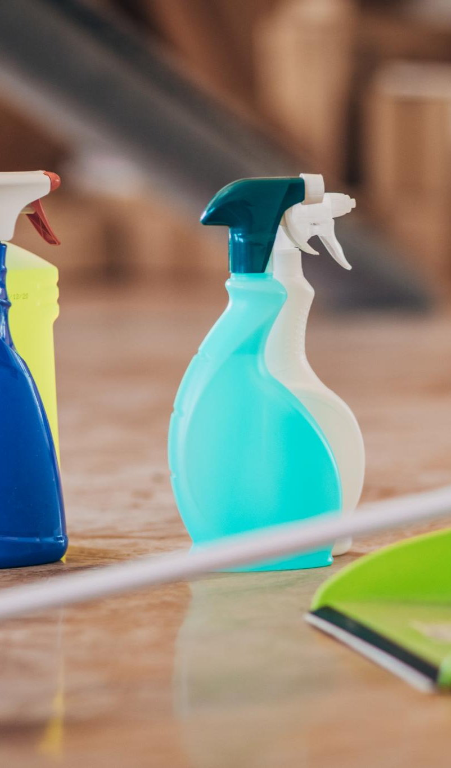
Summary of business setup steps and details (Thai language)
Comprehensive Business Setup
Outlined step-by-step process covers legal, financial, and operational requirements for starting a cleaning business in Thailand.
Government Regulatory Compliance
Interaction with agencies like DBD and Revenue Department ensures adherence to Thai business regulations and licensing.
Environmental and Labor Considerations
Emphasis on eco-friendly practices and local labor laws, including employee registration and social security compliance.
Ongoing Compliance and Operations
Annual financial reporting, license renewal, and marketing activities ensure sustained legal and operational business status.
Notes:
--- This slide references information from the following file: https://nextflowth-my.sharepoint.com/personal/teerasej_nextflowth_onmicrosoft_com/_layouts/15/Doc.aspx?sourcedoc=%7BFB659DDD-7793-449A-868A-0B52F230D32C%7D&file=Business%20Idea.docx&action=default&mobileredirect=true&DefaultItemOpen=1 Key Observations: - The table outlines a comprehensive step-by-step process for establishing a cleaning business in Thailand, with a focus on legal, financial, and operational requirements. - Several steps involve interaction with government agencies, such as the Department of Business Development (DBD) and the Revenue Department, highlighting regulatory compliance. - Environmental considerations and local labor laws are emphasized, particularly in service definition and employee registration. - Ongoing compliance, including annual financial reporting and license renewal, is required for continued operation. Detailed Analysis: The table presents a structured workflow for setting up a cleaning business in Thailand, beginning with business planning and service definition, which includes an emphasis on eco-friendly practices. It then guides the entrepreneur through legal entity selection, company name reservation, and the preparation of necessary documents, especially for foreign shareholders. Registration with the DBD, obtaining a company seal, and tax identification are mandatory steps, followed by opening a business bank account. The process also covers VAT registration for businesses exceeding a certain revenue threshold and obtaining specific business licenses, particularly for cleaning services that may require environmental checks. Employee hiring and social security registration ensure compliance with local labor laws. The workflow concludes with procurement of equipment, marketing activities, and ongoing regulatory requirements such as annual financial statements and license renewals, ensuring the business remains legally and operationally sound. Image source: Microsoft 365 content library

Slide 18
Additional Resources
Notes:
--- This slide references information from the following file: https://nextflowth-my.sharepoint.com/personal/teerasej_nextflowth_onmicrosoft_com/_layouts/15/Doc.aspx?sourcedoc=%7BFB659DDD-7793-449A-868A-0B52F230D32C%7D&file=Business%20Idea.docx&action=default&mobileredirect=true&DefaultItemOpen=1 Helpful resources for starting a business

Slide 19

Helpful resources for starting a business
Company Registration Help
ExpatDen provides comprehensive guidance for company registration in Thailand.
Investor Guidance
The Bangkok Investor Guide offers crucial information for business investments in Thailand.
Business Startup Advice
Thailand Life resource supports entrepreneurs with steps for starting a business effectively.
Notes:
--- This slide references information from the following file: https://nextflowth-my.sharepoint.com/personal/teerasej_nextflowth_onmicrosoft_com/_layouts/15/Doc.aspx?sourcedoc=%7BFB659DDD-7793-449A-868A-0B52F230D32C%7D&file=Business%20Idea.docx&action=default&mobileredirect=true&DefaultItemOpen=1 Helpful Resources: · ExpatDen: Company Registration in Thailand · Bangkok Investor Guide · Thailand Life: Starting a Business in Thailand Image source: Microsoft 365 content library

Slide 20
Conclusion
Business Idea Overview
The presentation detailed a clear business idea focused on cleaning services tailored for the Thai market.
Market Insights
Market analysis highlighted opportunities and customer needs within Thailand’s cleaning industry sector.
Setup and Operations
Step-by-step setup and operational planning are essential for launching and sustaining the business effectively.
Notes:
In summary, this presentation has covered the business idea, market insights, setup steps, and operational plans. Following these guidelines will help establish a successful cleaning business in Thailand.

